Slide 1
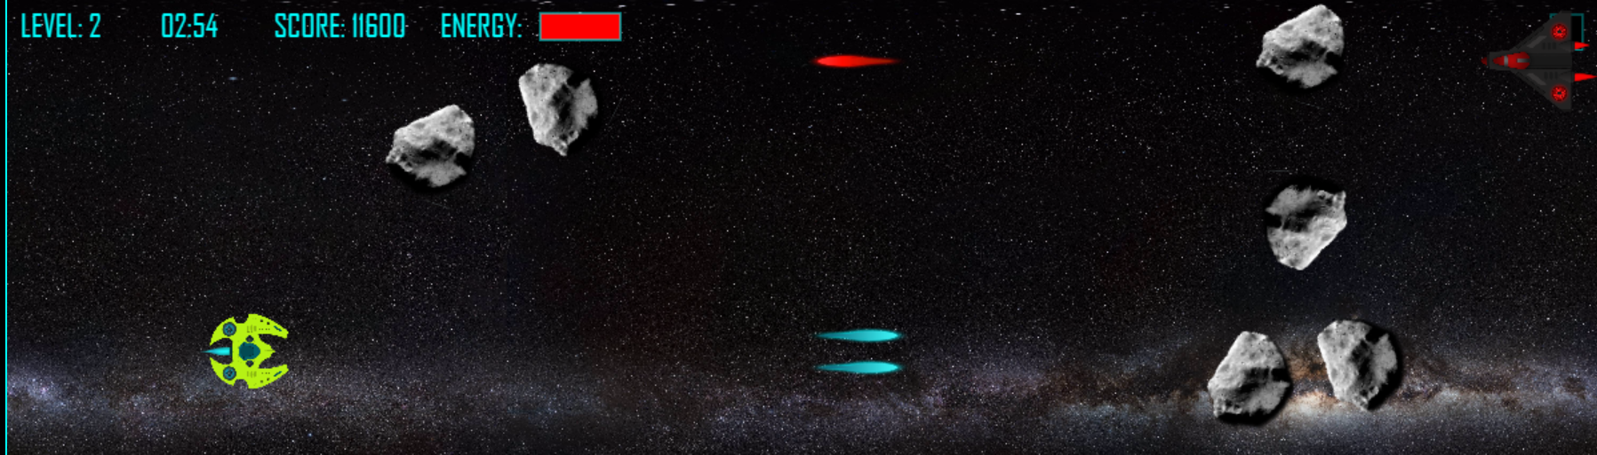

AIRFIRE
Andre Lemos,
Fabio Ciconi and
Rodrigo Geronimo

Slide 2
Schedule
Game Idea
Game World and Story
Characters
Game Progression
Game
Lessons Learned
Future Features

Slide 3
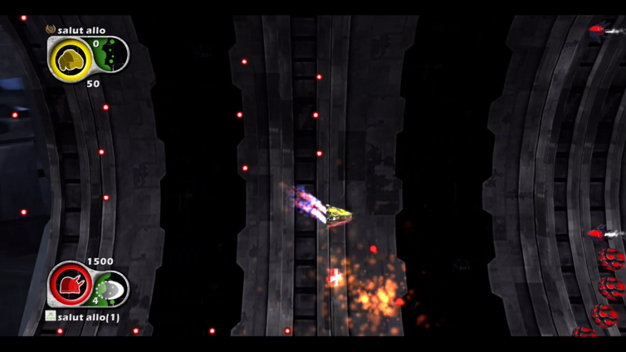
Game Idea
Fabio loves to play shooting game
Games was based AEGIS WING

Slide 4
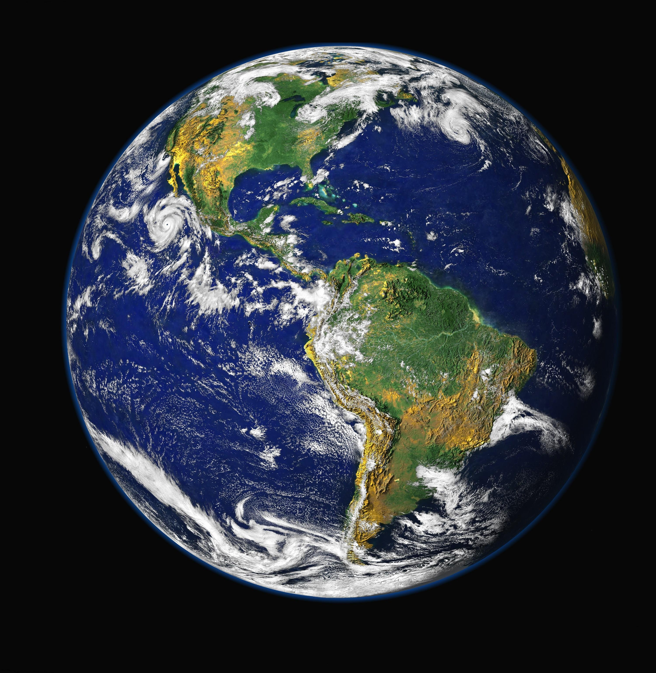
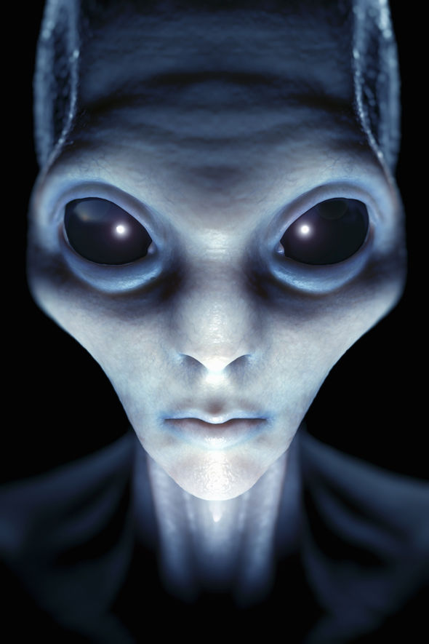
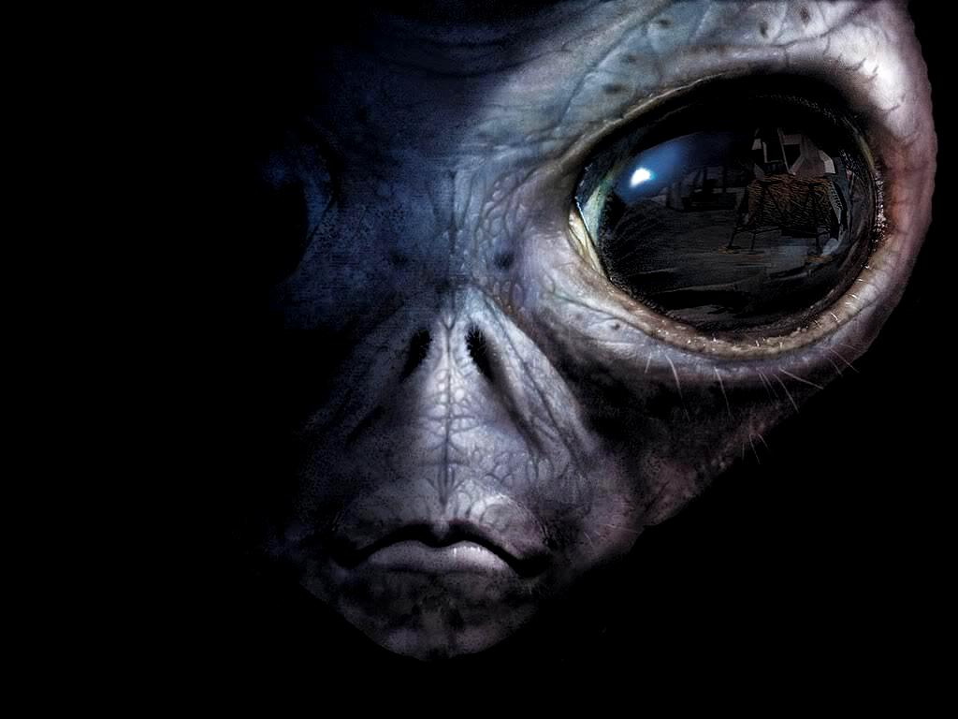
Game World
2100 - 83 years in the future
The humankind remains living on earth.
We are not alone in universe

Slide 5
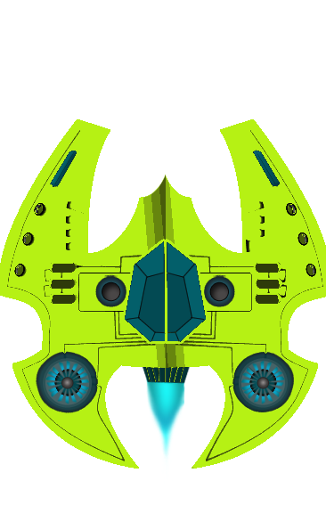
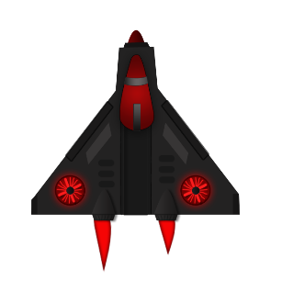

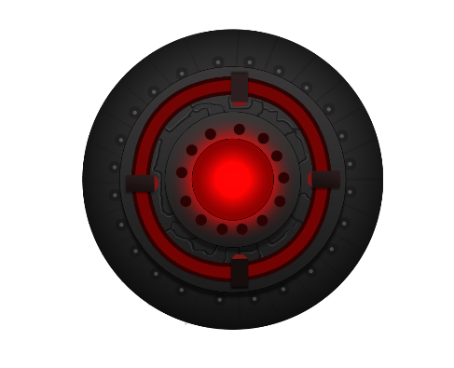
Characters
Hero AirFire007
Aliens spaceship
Asteroids
Mother alien spaceship

Slide 6
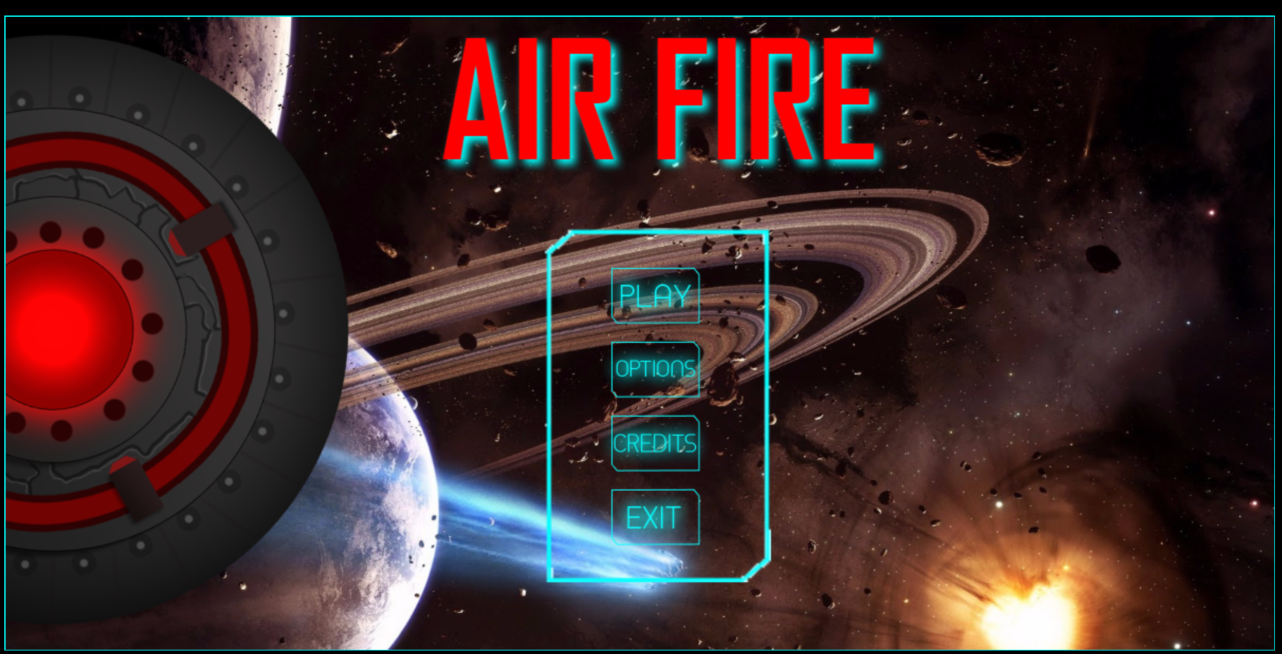
Game Menu

Slide 7
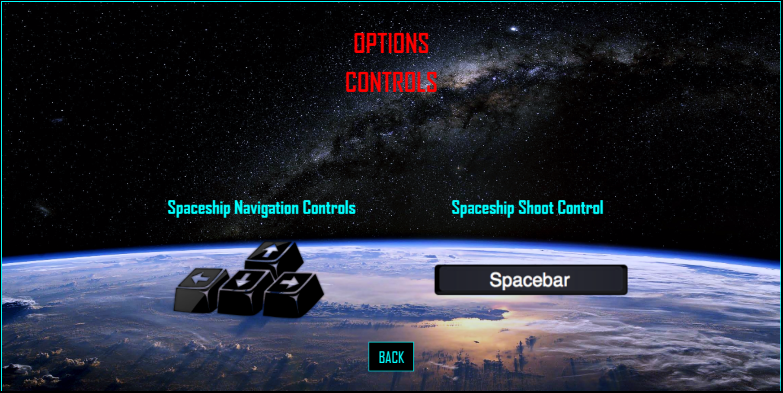
Game Options

Slide 8
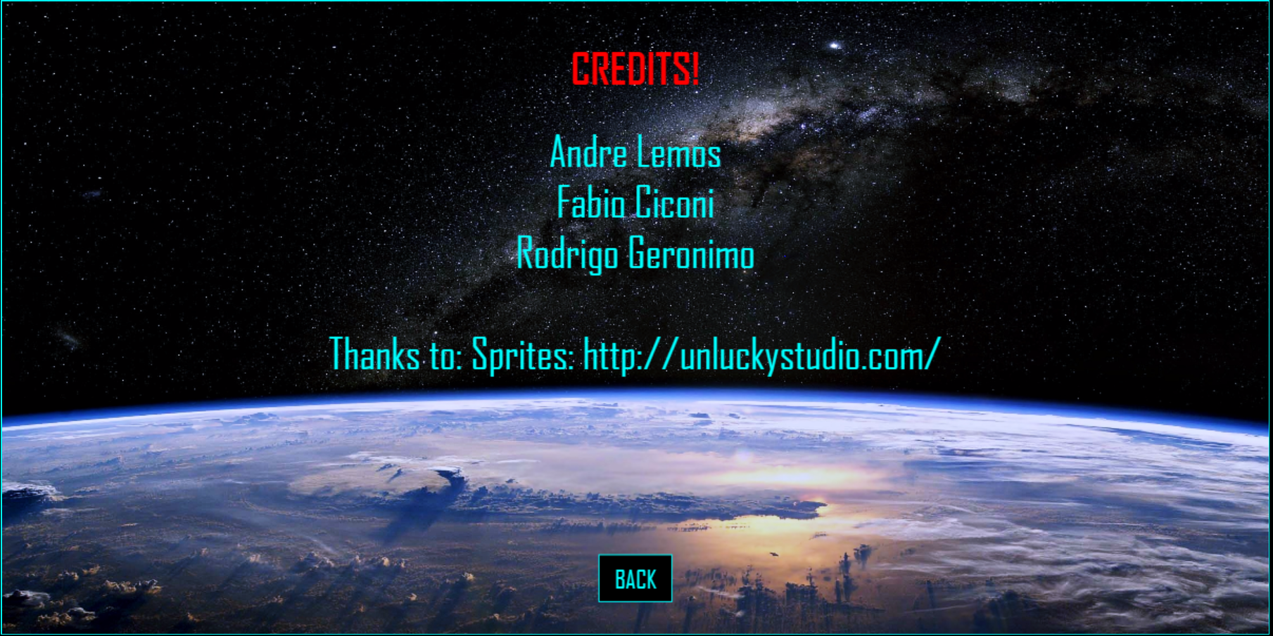
Game Credits

Slide 9
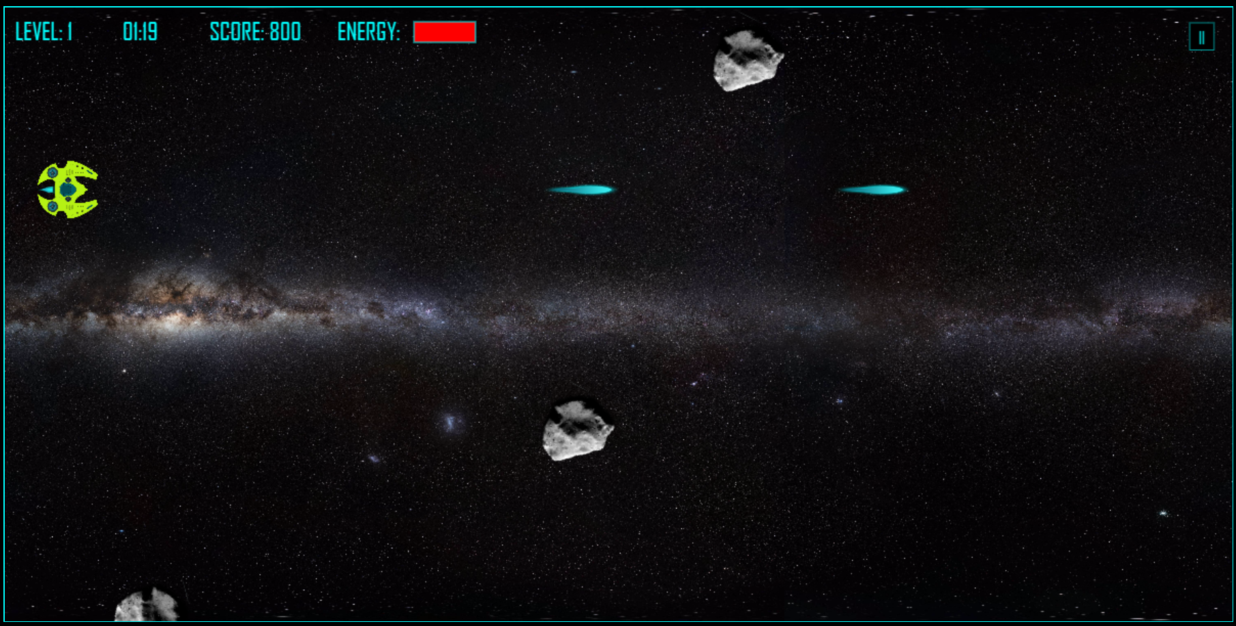
Level 1

Slide 10
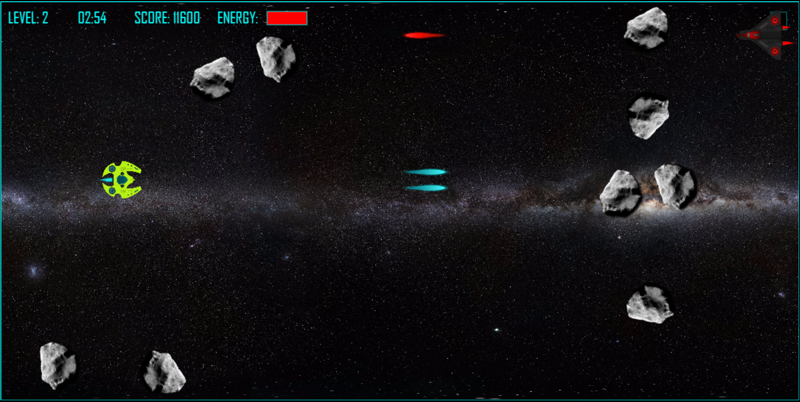
Level 2

Slide 11
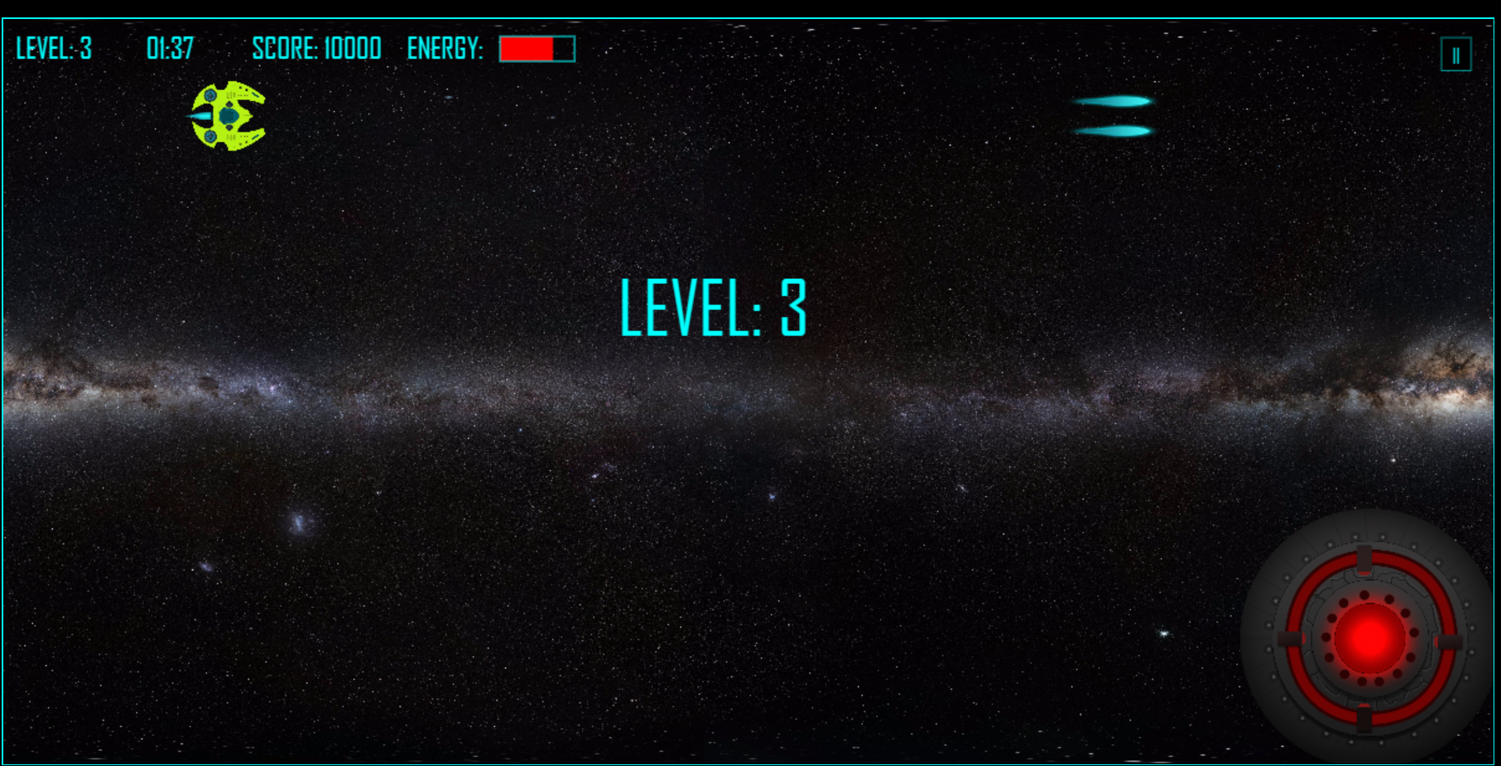
Level 3

Slide 12
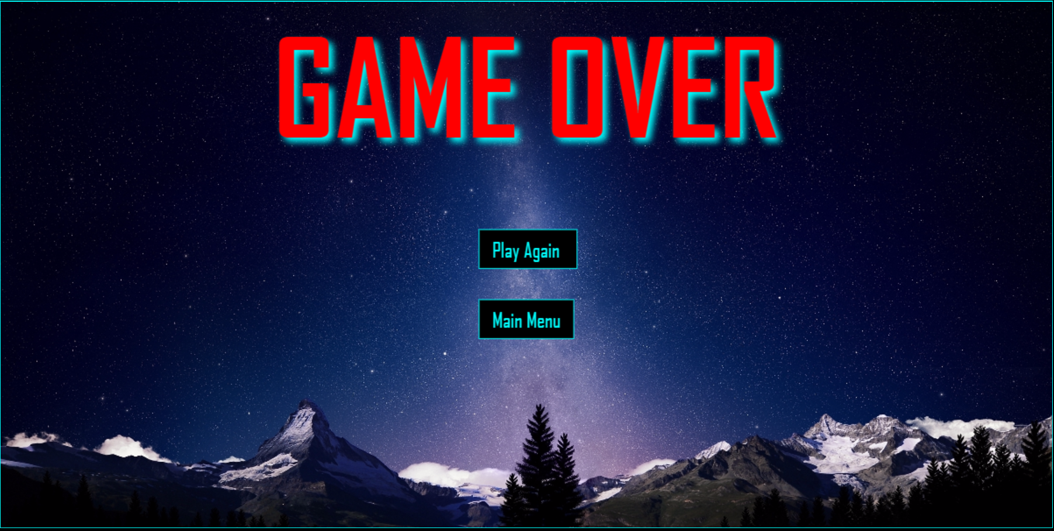
Game Over

Slide 13
Lessons Learned
CreateJs
Collision
Responsive

Slide 14
Future Features
Multiplayer Platform
New Stages
New Aliens
New Planets

